Slide 1
ATTENDANCE MONITORING USING AMAZON WEB SERVICES (A.W.S)
Sai Kishan Kranthi Kumar V¹,Manoj Ram Kumar K², Gnanapriyanka G³, Sandhya Rani G⁴
Department of Electronics and Communication engineering
Aditya Institute of Technology and Management, Tekkali
manojramkumar13@gmail.com,gurugubellignanapriyanka18@gmail.com,rani27396@gmail.com,vuritisaikissan08@gmail.com.
<number> / 3

Slide 2


Problem Statement:
Attendance has always been a conventional
thing, right from the beginning at every sector.
Attendance monitoring system always requires
a physical server and requires more data storage.
It is less accurate in capturing the data and takes
more time.

Slide 3
Objectives:
Tracking the user’s Attendance by RFID.
Grouping it together by using a Micro Controller.
Automated passage towards the A.W.S cloud.
Converting the collected data into the respective format.
Sending/Recieving the data through a mail.
<number> / 3

Slide 4



Methodology:
RFID Reader module is a radio frequency transceiver where cards are scanned against their corresponding Reader.
ESP32 is a Micro-Controller which helps us to achieve the connection between the RFID as well as cloud.
AWS cloud is the platform which enables that the users data to be encrypted and can be utilized in a manner that they wants.
<number> / 3

Slide 5







Groundwork of A.W.S:
IoT Rule
AWS IoT Core
DynamoDB
RFID Module
S3 Bucket
SES
ESP32 Module
Lambda
<number> / 3

Slide 6
Explications:
Human work has been reduced.
Cost Effective.
Works Automatically.
Efficient storage of Data.
Accurate in receiving of Data.
<number> / 3

Slide 7
Results:
As soon as the student scans his card over the RFID reader, the name of the student along with the roll number appears on the LCD display. The ESP32 board then sends updates the THING shadow accordingly. The proposed system achieves in not only capturing the student's data but also provides storage facility via a virtualized server platform A.W.S and the output is easily accessible to the recipient through the mail as shown in figure 8 through AWS lambda serverless platform.

Slide 8
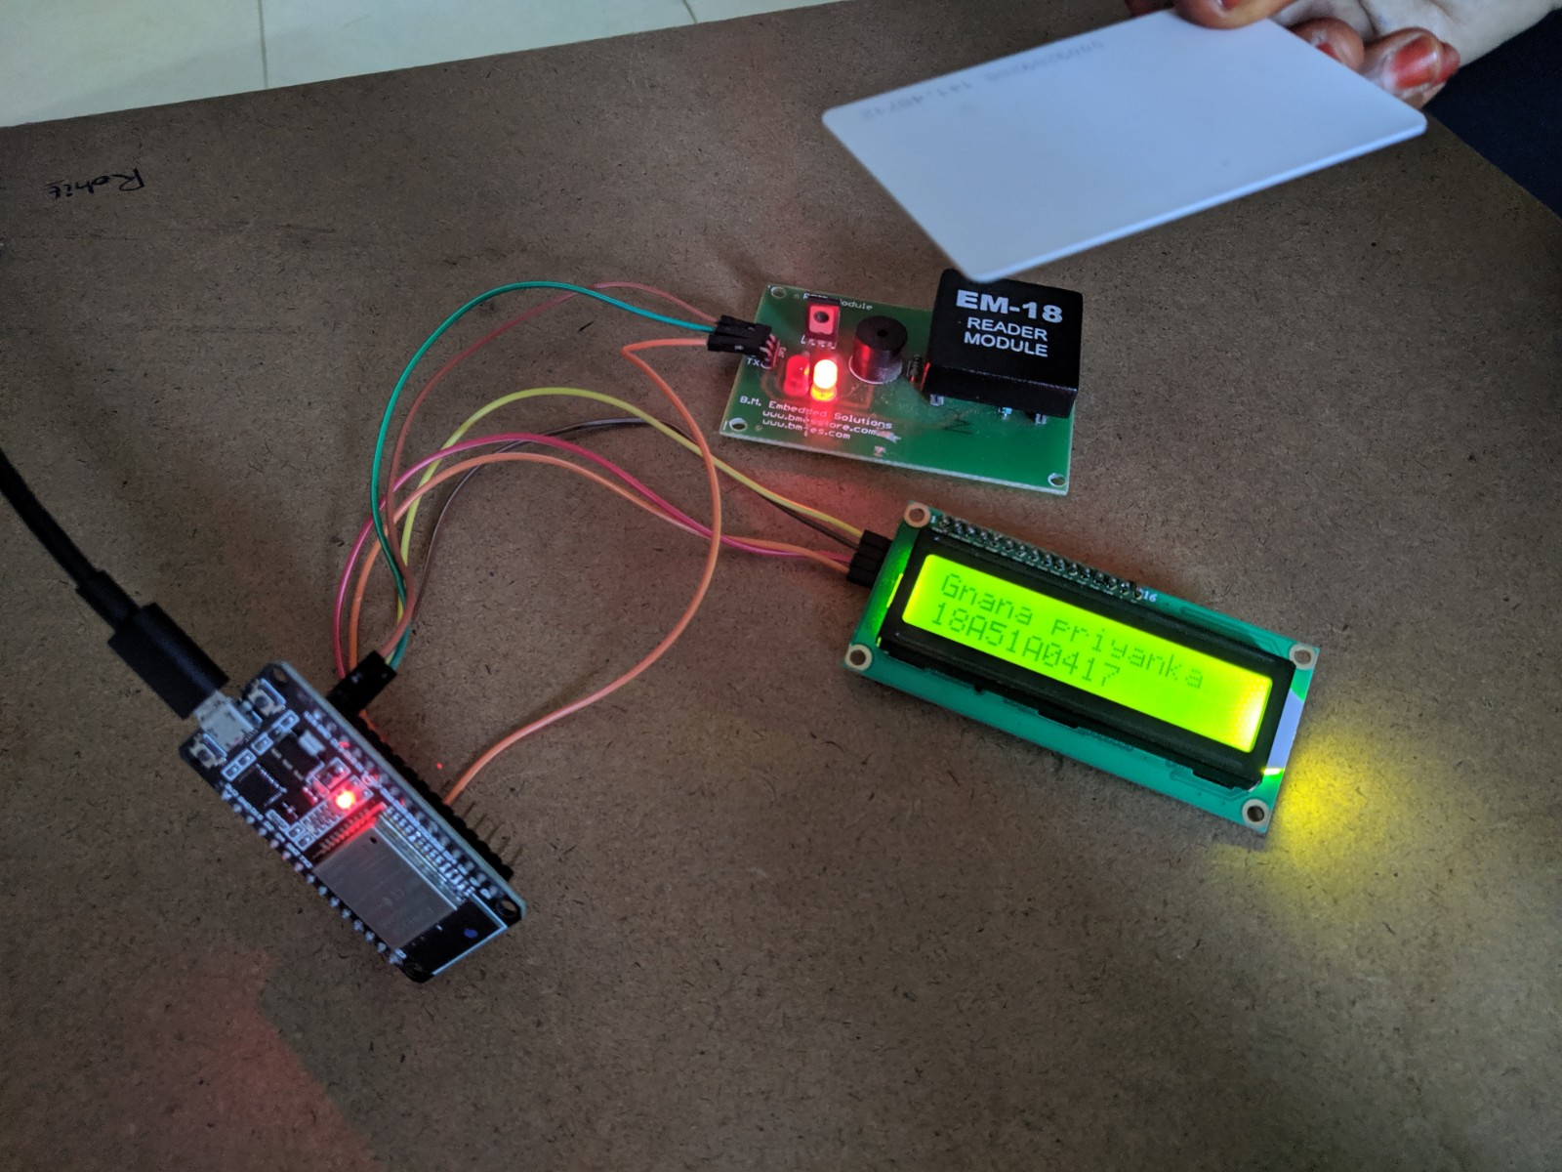
Outcome-1:

Slide 9
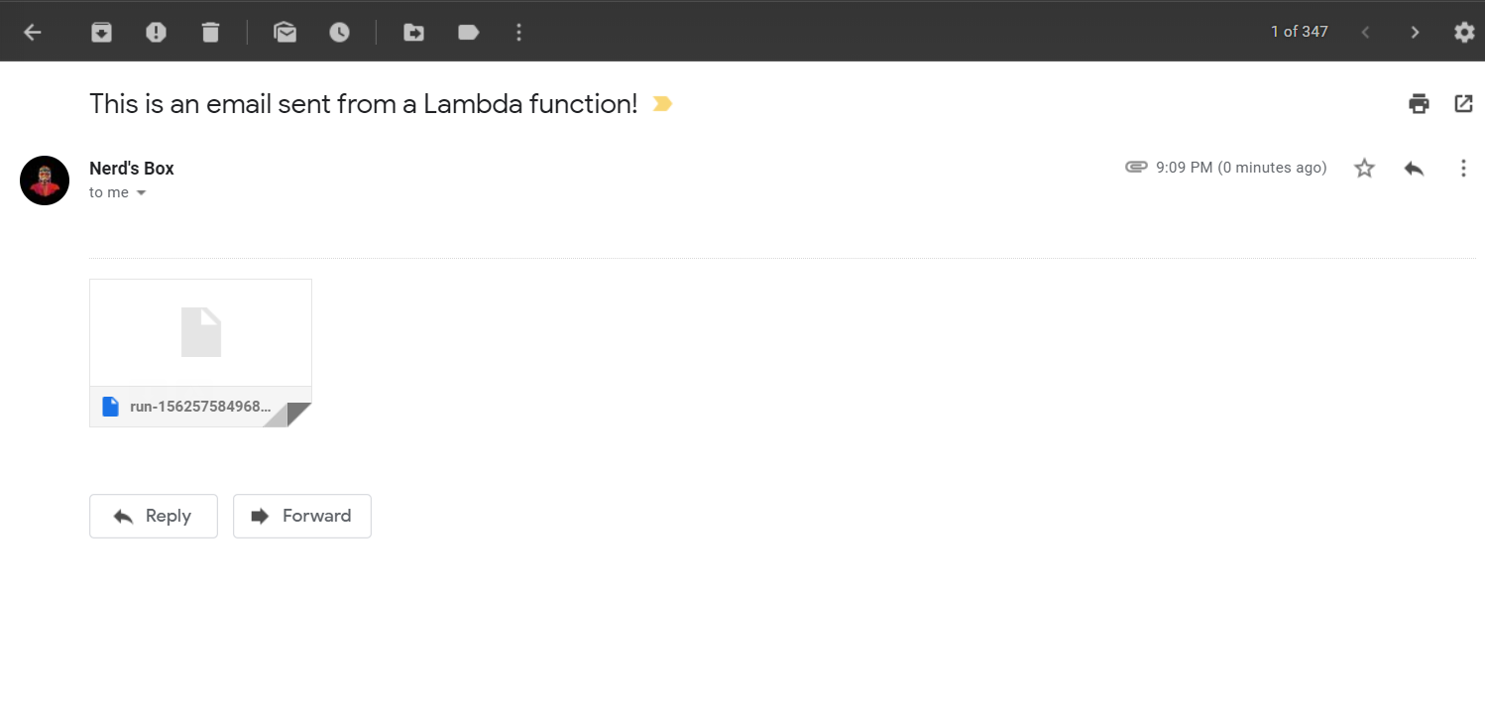
Outcome-2:

Slide 10
Conclusion:
An Attendance Monitoring System is designed to manage a user's day to day attendance. Also, the proposed system provides an ease of access since there is no extra paper work. This results in achieving the usage of AWS cloud computing and RFID Interface in an innovative manner, helps us to overcome the traditional attendance.

Slide 11
Thank You

